Slide 1


Department of Artificial Intelligence and Data Science
INVENTORY OPTIMIZATION USING AI CHATBOT
Akshaya M
(221801002)
Bharath Kumar S
(221801006)
Supervisor
Dr.V.SaravanaKumar

Slide 2
Problem Statement and Motivation
PROBLEM STATEMENT
A leading online retailer wants to optimize its inventory management system by analyzing historical sales data. They aim to reduce stockouts and overstock situations while improving inventory turnover rates.
MOTIVATION
Optimizing inventory management by analyzing historical sales data will enable the retailer to minimize costly stockouts and overstock situations, thereby enhancing customer satisfaction and operational efficiency.

Slide 3
Abstract
Stock out and overstocking of products have been a major issue for all e-commerce websites.
To overcome this, we use time series forecasting models, like Exponential Smoothing and Moving average, and calculating EOQ and MAE to optimize inventory management. By analyzing historical sales data, it aims to improve demand predictions, reducing the risk of stockouts and overstock. This will enhance inventory turnover and overall operational efficiency.

Slide 4
Objectives
To leverage Moving Average and Time series forecasting models to accurately predict future sales demand, pattern,trends for each products thereby minimizing stockouts and overstock situations, and enhancing inventory turnover rates.

Slide 5
Introduction and Overview of the Project.
Inventory management involves supervising inventory and stock items to ensure that the right amount of products is available at the right time, maintaining the balance between supply and demand.
The project aims to optimize the inventory management system of a leading online retailer by analyzing historical sales data to reduce stockouts and overstock situations, improving inventory turnover rates. It includes assessing demand uncertainty and evaluating EOQ, MAE models for effective management using moving averages

Slide 6
Existing System
ARIMA (AutoRegressive Integrated Moving Average), XG Boost and Demand Forecasting models are commonly used in inventory management to predict future demand by analyzing historical sales data.
It helps in optimizing stock levels, reducing overstock and understock situations, and minimizing costs.
They make accurate demand predictions by incorporating multiple features, such as price changes, promotions, and external factors like holidays or economic conditions

Slide 7
Drawback of Existing System
1. XGBoost and Demand Forecasting are prone to overfitting, especially if not tuned properly.
2. They might struggle with highly sporadic or irregular demand patterns typical of slow-moving inventory items.
3. Implementing them for real-time inventory management can be challenging due to its computational requirements.
4. Proper implementation and interpretation of forecasting systems often depend on the availability of skilled personnel

Slide 8
Literature Survey
S.No | Author Name | Paper Title | Description | Journal | Volume/ Year
 | 1. Manal Loukili 2.Fayçal Messaoudi 3.Mohammed El Ghazi 4.Hanane Azirar | Predicting Future Sales: A Machine Learning Algorithm Showdown | This paper uses machine learning models, including XGBoost and LSTM, to forecast sales, with XGBoost achieving the highest accuracy, highlighting its value in improving sales predictions and inventory management. | IEEE FORMAT | 2021
2. | 1.Devesh Yadav 2.Deepak Jaiswal 3.Ashutosh Mishra | Store-sales Forecasting Model to Determine Inventory Stock Levels using Machine Learning | This study uses Random Forest and XGBoost to predict store sales, with XGBoost delivering the highest accuracy. | IEEE FORMAT | 2022
3. | 1.Praveen KB 2.Pradyumna kumar 3.Pragathi G | Inventory management using machine learning | Inventory management for small/medium businesses by reducing costs and minimizing overstock and stockouts | Research Gate | 2020
4. | 1.Mediavilla, M.A 2.Dietrich, F 3.Palm, D | Analysis of Demand Forecasting Method , | The paper reviews AI-based demand forecasting in supply chains, comparing it to traditional models, and highlights its benefits for inventory management, cost reduction, and customer satisfaction. | CIRP | 2022

Slide 9
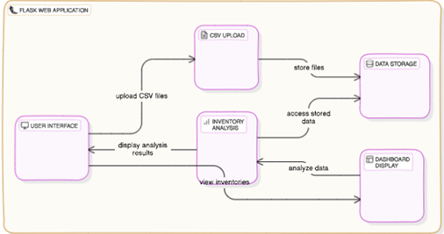
System Architecture

Slide 10
Proposed System
Objective: Predicting the high sales and low sales using demand forecasting to avoid overstock situation and prevent stockouts
Data collection and integration: Collecting the massive historical sales by integrating the external factor such as holidays festival economic trend.
Algorithm: Using demand forecasting in time series analysis and moving average
is used to find the sales trends and patterns for massive sale and low sale products with more accuracy
Visualization: By using tableau we visualize the data of inventory so that it would help to identify the trend and pattern to maintain stock prevention and overflow

Slide 11
List of modules
Data Collection and Preprocessing Module
Forecasting and Optimization Module
Reporting and Visualization Module
System Integration and Improvement Module

Slide 12
Module 1: Data Colection and Pre-Processing
1. Data Acquisition: Collecting raw data from various sources, such as databases, APIs, or CSV files, ensuring a diverse and comprehensive dataset for analysis.
2. Data Cleaning: Handling missing, incorrect, or inconsistent data by removing duplicates, filling in missing values, and correcting errors to improve data quality.
3. Data Transformation: Normalizing or standardizing data, converting formats, and encoding categorical variables to ensure consistency across the dataset for modeling.
4. Feature Extraction and Selection: Identifying and selecting the most relevant features (attributes) from the dataset that contribute significantly to the problem, improving the model’s performance and reducing complexity.

Slide 13
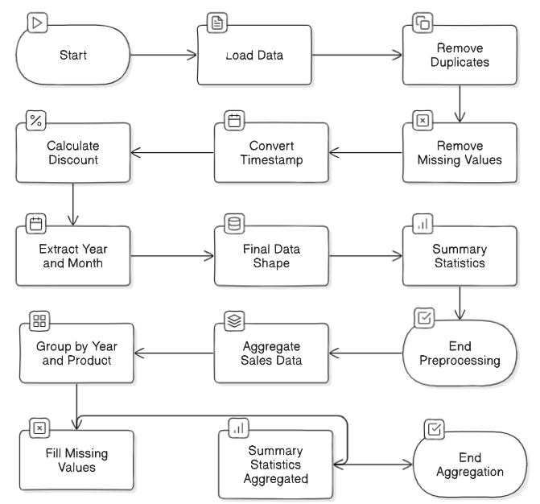
DATA FLOW DIAGRAM

Slide 14
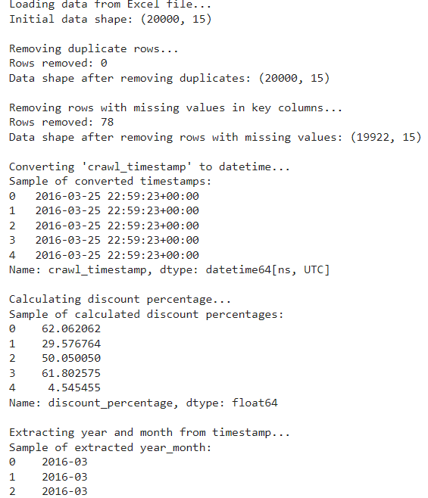
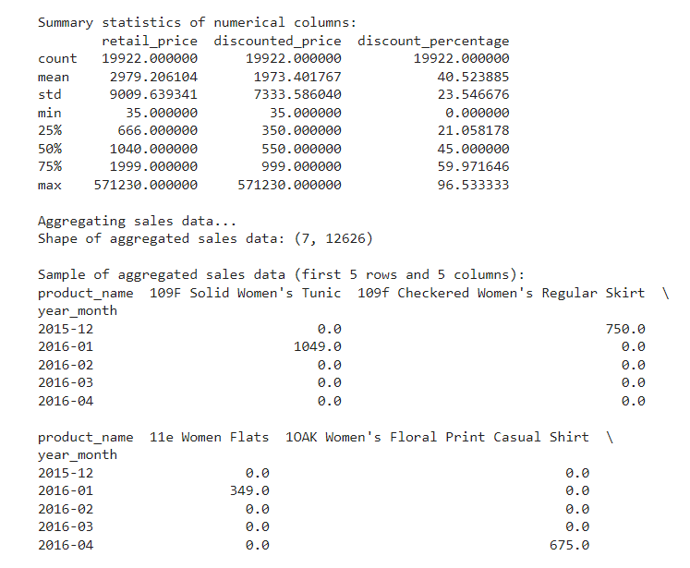
OUTPUT

Slide 15
Module 2: Forecasting and Optimization Module
1. Moving Avereage: Predicting future trends using historical data and models like time series or regression.
2. Model Selection: Choosing and tuning demand forecasting and moving average for better accuracy.
3. Optimization: Applying algorithms like linear programming to optimize inventory, costs, or resources.
4. Scenario Analysis: Exploring "what-if" scenarios to guide decision-making and improve resource management.

Slide 16

ALGORITHM
Moving Average Algorithm for Time Series Analysis
1. Define Time Series Data:
Let ( X = [x1, x2,......, xn] ), where ( xi ) is the value at time ( i ).
2. Select Window Size (k):
Choose a window size ( k ), typically 3, 5, or 10, based on the desired smoothness.
3. Calculate the Moving Average:
4. Handle Edge Cases:
- For ( i < k ), use:Simple Average: Average available points,Padding: Use zeros or the first value,Partial Window:Average available data.
5. Analyze the Result:
- The smoothed series ( MA ) reduces random fluctuations, aiding in trend analysis and anomaly detection.

Slide 17
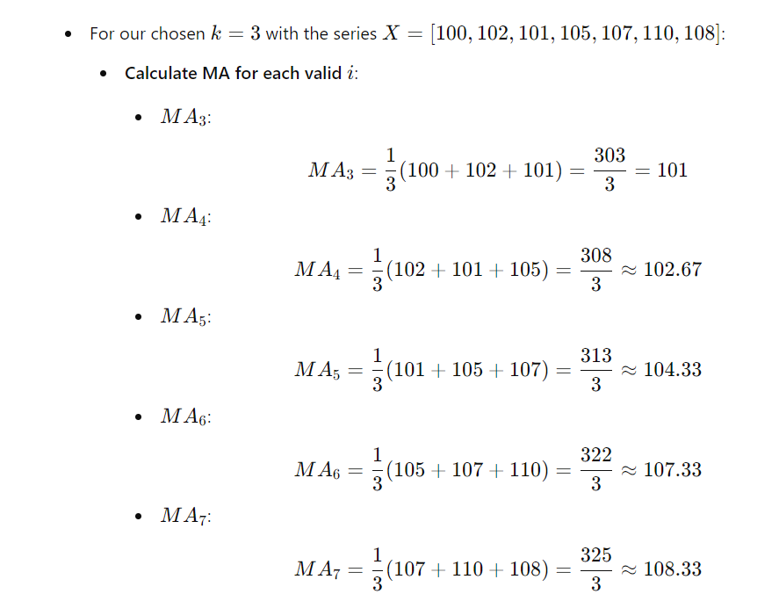

Slide 18
DATA FLOW DIAGRAM

Slide 19
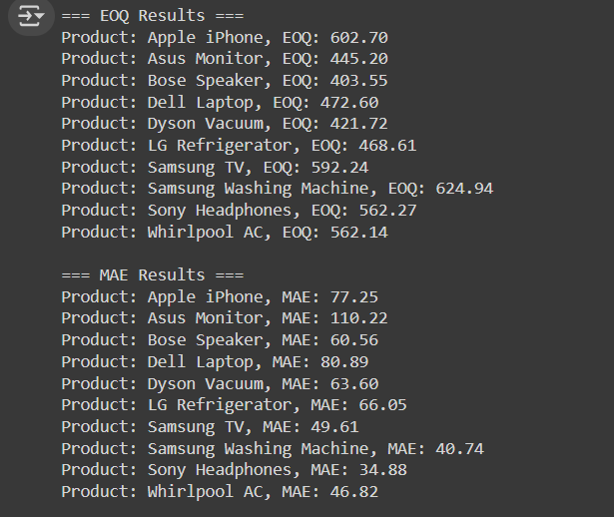
Output

Slide 20
ALGORITHM FOR MODULE 2
Step 1: Create a function named `forecast_demand` that takes in `product_sales` data as input.
Step 2: Check if the length of `product_sales` is at least 24 periods (e.g., 2 years of monthly data) to ensure sufficient data for seasonal analysis.
Step 3: Apply Holt-Winters Model
- If the data length condition is met, apply the Holt-Winters Exponential Smoothing model with:
- Additive trend (`trend='add'`)
- Additive seasonal component (`seasonal='add'`)
- Seasonal period set to 12 (assuming monthly data).

Slide 21
ALGORITHM FOR MODULE 2
Step 4: Fit the model to the `product_sales` data.
Step 5: Forecast the next 12 periods using the fitted model.
Step 6: Handle Insufficient Data:
If data length is less than 24 periods, use a simple moving average:
Apply a rolling window of 3 periods.
Use a forward shift (`shift(-1)`) to align the forecast with future periods.
Fill any missing values forward (`fillna(method='ffill')`).
Select the last 12 periods of the moving average as the forecast.
Step 7: Return the forecasted values from the function.
- Return the aggregated forecasts for all products.

Slide 22
Step 8: Create a function named `apply_forecasting` that takes `sales_data` as input.
Step 9: Apply Forecasting Across Products
Use the `.apply()` method to apply the `forecast_demand` function across each product (axis=0) in the `sales_data`.
Step 10: Return Forecasts
Return the aggregated forecasts for all products.

Slide 23
Module 3:Reporting and Visualization Module
1. Data Aggregation: Collect and clean data from multiple sources for accurate insights.
2. Customizable Dashboards: Allow users to create personalized dashboards with interactive filters and KPIs.
3. Real-time Analytics: Provide real-time data monitoring for quick decision-making.
4. Export & Sharing: Support exporting reports in various formats and automate their distribution.

Slide 24
Data Flow Diagram

Slide 25
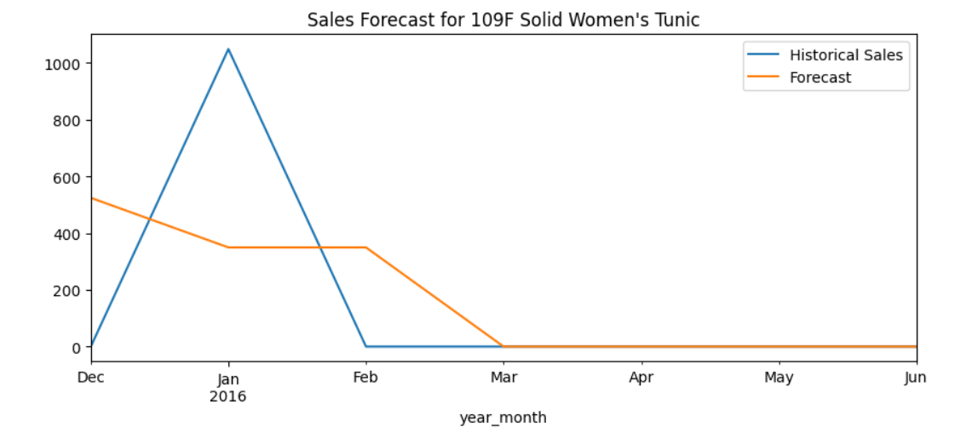
Output

Slide 26
Module 4:System Integration and Improvement Module
1. Seamless Integration: Connects various software, hardware, and systems to work together as one.
2. Performance Optimization: Enhances efficiency by refining processes and reducing bottlenecks.
3. Scalability and Flexibility: Ensures the system can grow and adapt to future needs.
4. Monitoring & Improvement: Tracks performance and continuously improves through feedback and optimization.

Slide 27
Data Flow Diagram

Slide 28
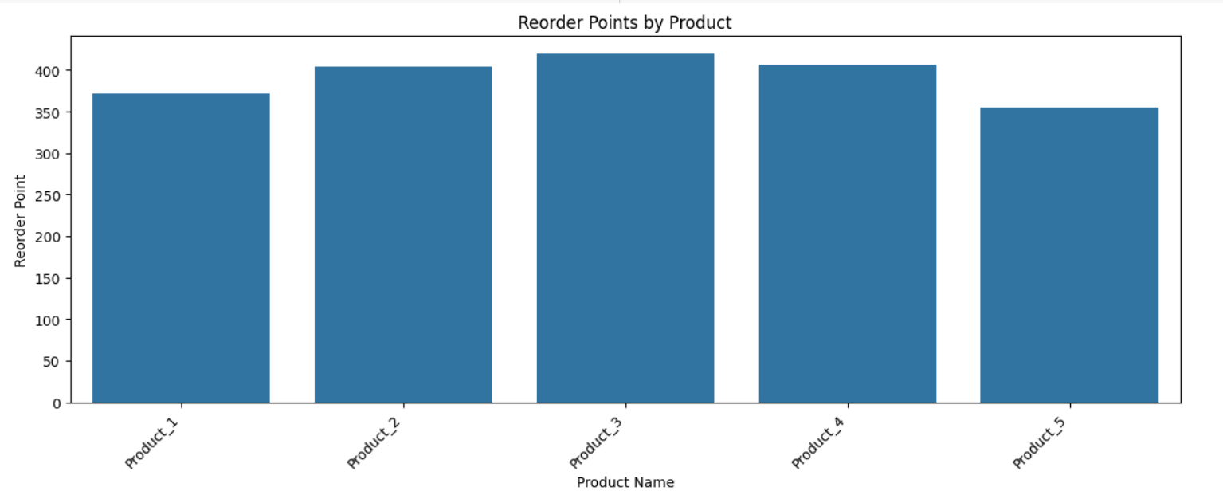
Output

Slide 29
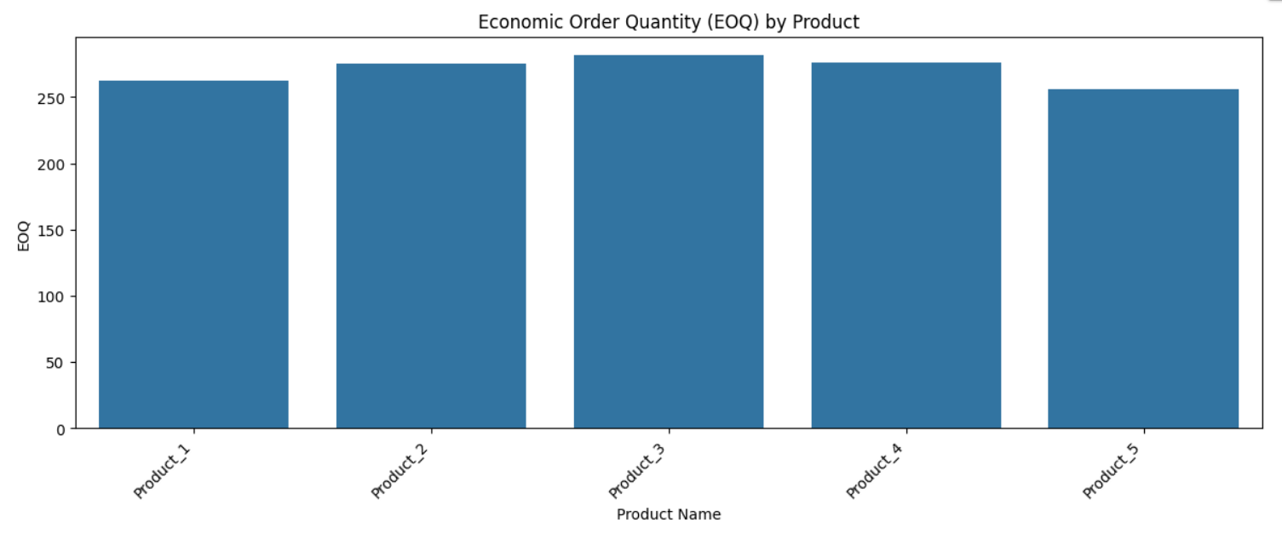
Output

Slide 30
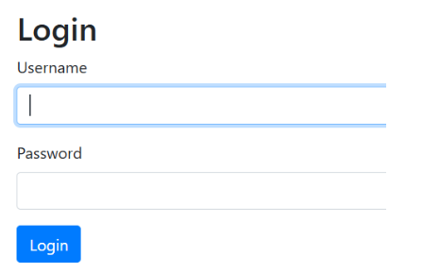
Website Outcome

Slide 31
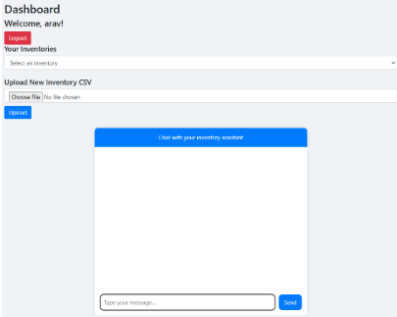
Website Outcome

Slide 32
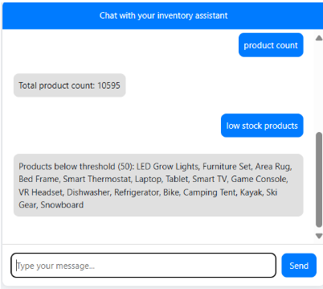
Website Outcome

Slide 33
Results and Discussion
The chatbot for inventory management, utilizing time series analysis and demand forecasting, provides accurate and real-time insights into stock levels and demand trends. Using techniques like moving averages, exponential smoothing, and Economic Order Quantity (EOQ), it effectively predicts which products have high or low sales, reducing overstock and understock situations. The chatbot evaluates forecast accuracy through Mean Absolute Error (MAE) and integrates user-uploaded data to refine its predictions continually. This system not only automates inventory suggestions but also assists managers in making informed decisions to maintain optimal stock levels. Additionally, the chatbot interactive nature makes it user-friendly, allowing managers to query specific product performance, streamline replenishment schedules, and adapt to changing market demands efficiently.

Slide 34
Conclusion
The chatbot for inventory management, powered by time series analysis and demand forecasting, has proven to be an effective tool for maintaining optimal inventory levels. By automating the prediction of high and low-demand products, it reduces risks of overstock and understock, improving operational efficiency and reducing costs. The system’s ability to analyze historical sales data and generate actionable insights makes it a valuable asset for decision-making in inventory control, providing a scalable solution adaptable to various inventory scenarios.

Slide 35
References
Mediavilla, M.A., Dietrich, F., Palm, D.: Review and analysis of artificial intelligence methods for demand forecasting in supply chain management. In: CIRP Conference on Manufacturing Systems, pp. 1126–1131 (2022)
Manal Loukili1 ,Fayçal Messaoudi ,Mohammed El Ghazi1 and Hanane Azirar: Predicting Future Sales: A Machine Learning Algorithm Showdown
Loukili, M., Messaoudi, F., El Ghazi, M.: Supervised learning algorithms for predicting cus tomer churn with hyperparameter optimization. Int. J. Adv. Soft Comput. Appl. 14(3), 49–63 (2022).
Farhaoui, Y., et al.: Big data mining and analytics 5(4), I–II (2022)

Slide 36
Thank You

Slide 39
ALGORITHM FOR MODULE 1: PANDAS
Step 1: Load the Excel file from the given file path into a pandas DataFrame.
Step 2: Eliminate any duplicate entries in the dataset to ensure data uniqueness.
Step 3: Drop rows where `retail_price`, `discounted_price`, or `crawl_timestamp` columns have missing values to maintain data integrity.
Step 4:Convert the `crawl_timestamp` column to a datetime format for accurate date handling.
Step 5: Compute the discount percentage using the formula:

Slide 40
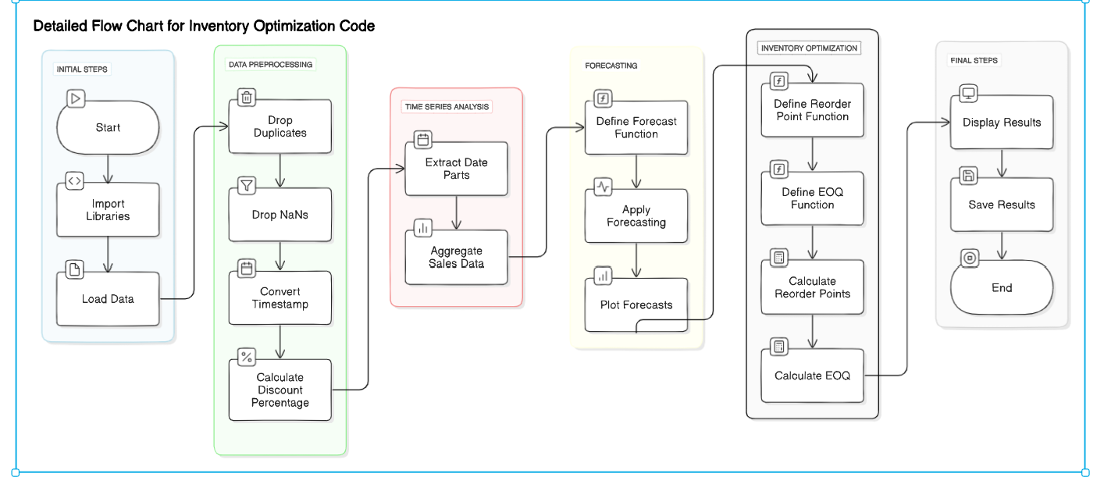
MODULES

Slide 41
ALGORITHM FOR MODULE 1: PANDAS
Step 6: Extract the year and month from `crawl_timestamp` to create a `year_month` column, which simplifies time-based grouping.
Step 7: Group the data by `year_month` and `product_name`.
Sum the `discounted_price` for each group to get the total monthly sales for each product.
Step 8: Reshape the aggregated data into a wide format with `product_name` as columns, filling any missing values with zero.

Slide 42
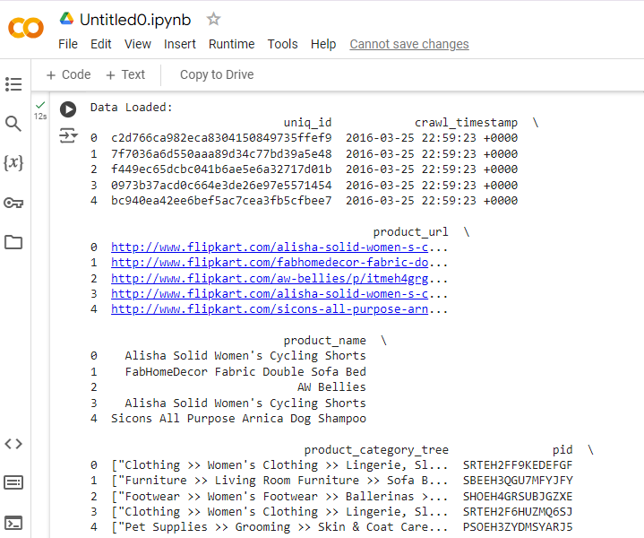
OUTPUT

Slide 43
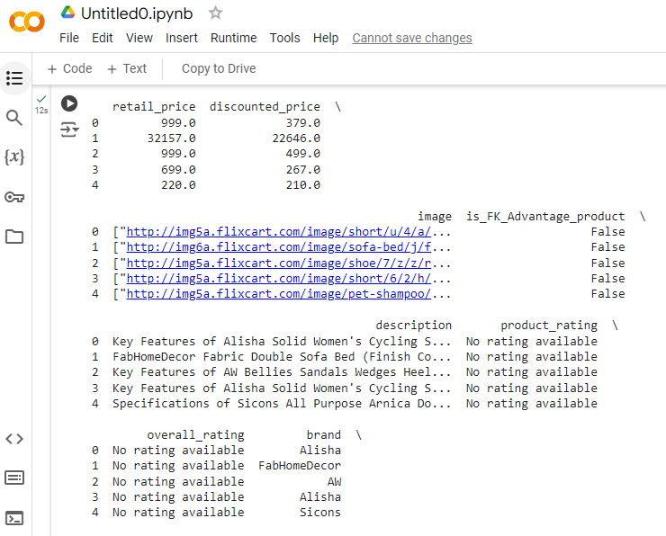

Slide 44
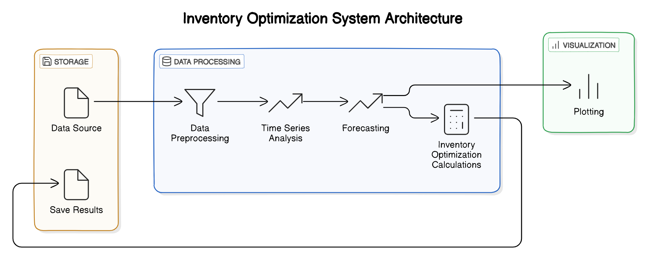

Slide 45
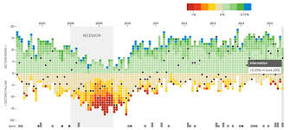
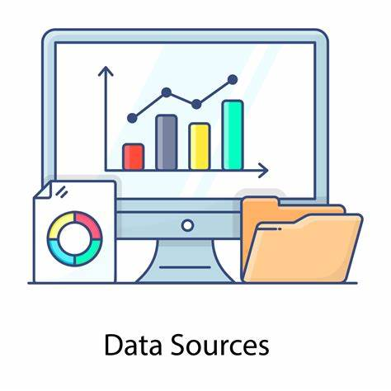

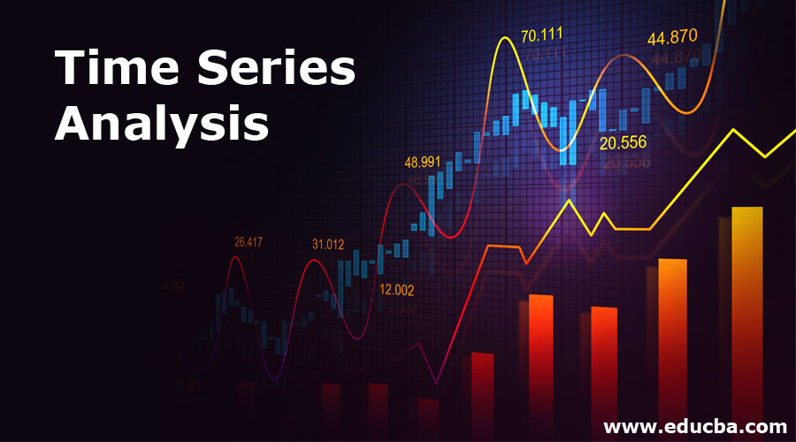

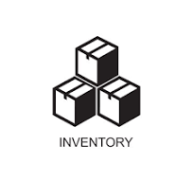

System Architecture
Raw Data Source

